Slide 1
Wizards
29 August 2011
Notes:
Wizards - <number>
Guidewire training materials contain Guidewire proprietary information that is subject to confidentiality and non-disclosure agreements. You agree to use the information in this manual solely for the purpose of training to implement Guidewire software solutions. You also agree not to disclose the information in this manual to third parties or copy this manual without prior written consent from Guidewire. Guidewire training may be given only by Guidewire employees or certified Guidewire partners under the appropriate agreement with Guidewire.

Slide 2
Lesson objectives
By the end of this lesson, you should be able to:
  Describe the architecture of a wizard
  Configure existing wizards
  Create and modify wizard steps
  This lesson uses the notes section for additional explanation and information.
  To view the notes in PowerPoint, choose View→Normal or View→Notes Page.
  If you choose to print the notes for the lesson, be sure to select “Print hidden slides.”
Notes:
Wizards - <number>

Slide 3
Lesson outline
Wizard basics
Wizard configuration
Wizard step configuration
Notes:
Wizards - <number>

Slide 4
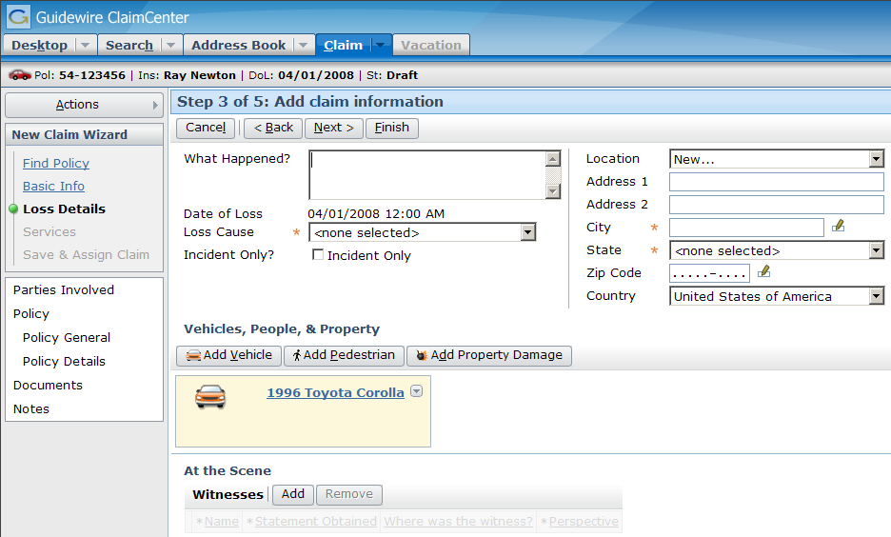
Wizards
A wizard is a location that contains multiple screens in a specific order and a toolbar to work through the wizard
Notes:
Wizards - <number>
A wizard has multiple screens, but only one screen is displayed at a time. The screens in a wizard have an order (though it may be possible for a user to traverse the screens out of order).

Slide 5
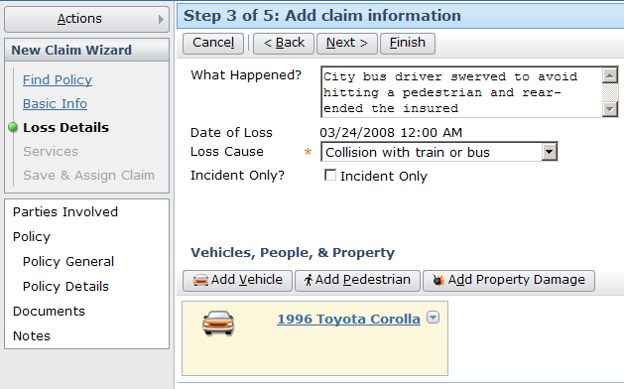
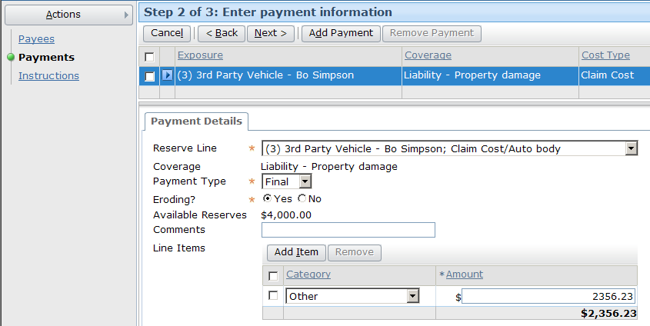

Wizards in the base application
FNOL Wizard
1
2
3
1
2
3
Normal Create Check Wizard
Notes:
Wizards - <number>
The ClaimCenter base application comes with eight wizards. The two most frequently used wizards are arguably the FNOL Wizard (also commonly referred to as the "New Claim Wizard" or the "NCW") and the Normal Create Check Wizard (also commonly referred to as the "Payment Wizard"). The FNOL wizard contains all the screens for all lines of business (such as "New Claim - Auto" and "New Claim -Property") and all levels of detail (such as the full wizard, the quick wizard, and the Auto line of business's "First and Final" wizard).
The base application also includes:
The Import Wizard (used on the Administration screen for importing data)
The Clone Check Wizard
The Edit Check Wizard
The Edit Recurrence Check Wizard
The Manual Create Check Wizard
The Quick Create Check Wizard

Slide 6
Comparing wizards and location groups
Both are assigned to a single tab
Both reference multiple screens
Both can have a set of screens
that have no inherent order
Both have a shared info bar and side bar
Notes:
Wizards - <number>

Slide 7
Contrasting wizards and location groups
1
2
3
4
5
screen
ref
Wizards have a toolbar specifically for navigating through the screens
Wizard access screens directly (as opposed to using pages)
Wizards have a set of screens which have an inherent order
Wizard screen availability can be tied to where you are in the wizard
Notes:
Wizards - <number>
The independent screens (such as the Parties Involved, Policy General, and Documents screen in the example above) are accessible regardless of what step you are at in the wizard.
A distinction needs to be made between menu link availability and menu link visibility. Visibility controls whether a menu link appears or not. This functionality is available to both wizard and non-wizard menu links. Availability controls whether a visible menu link can be clicked on or not. This functionality is also available to both wizard and non-wizard menu links. However, availability for a wizard menu link is typically based on where a user is it within the wizard. Location within a wizard does not typically change a menu link's visibility.

Slide 8
Wizard's UI components
wizard infobar
wizard toolbar
actions menu
dependent steps
independent steps
screen
(which defines the UI contents of one step)
Notes:
Wizards - <number>
The following UI elements can be thought of as "building blocks" that are used to render a wizard:
Actions menu
Dependent steps, which are an ordered set of labels, each of which represents a single wizard step and maps to a single screen. Some steps may not be accessible until a given step is complete.
Independent steps, which are a set of labels, each of which maps to a single screen. Independent steps do not have a logical order and can be accessed at any time, regardless of what steps have been completed in the wizard.
Wizard infobar, which lists information about the policy, the insured, or the claim.
Wizard toolbar, which contains Back and Next buttons to navigate through the wizard as well as other buttons relevant to the current step.
Screens (for each step of the wizard).

Slide 9
Lesson outline
Wizard basics
Wizard configuration
Wizard step configuration
Notes:
Wizards - <number>

Slide 10
Internal architecture
Tab
Wizard
WizardStep
screen
WizardStepSet
WizardStep
screen
WizardStep
screen
Notes:
Wizards - <number>
The architecture of a wizard is more simplistic than that of a location group. A wizard's architecture consists of wizard steps, and each wizard step points directly to a screen. Often, wizard steps are grouped together into wizard step sets. Wizard step sets let developers specify logic which is identical for multiple steps. For example, if there was a series of wizard steps relevant only for property claims, they could be grouped into a wizard step set which had a visibility condition of "visible if the claim's loss type is property".

Slide 11
Wizard and wizard step configuration
Two levels of configuration
  Wizard-level
    Entry point and navigation to wizard
    Permissions to visit and edit
  Wizard-step-level
    Screen that a step renders
    Step logic (visibility, editability, next step)
    Step order
    Independent steps
Wizard
WizardStep
screen
WizardStep
screen
WizardStep
screen
Notes:
Wizards - <number>
The next section of this lesson discusses wizard-level configuration. The section after that discusses wizard-step-level configuration.

Slide 12
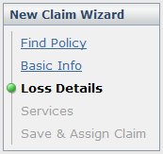

Information in wizard PCF file
FNOLWizard.pcf
info bar
Entry Point
menu actions
Wizard PCF file contains:
  Entry point and required objects
  Steps which point to screens
  Attributes that point to separate files for info bar and menu actions
Notes:
Wizards - <number>

Slide 13
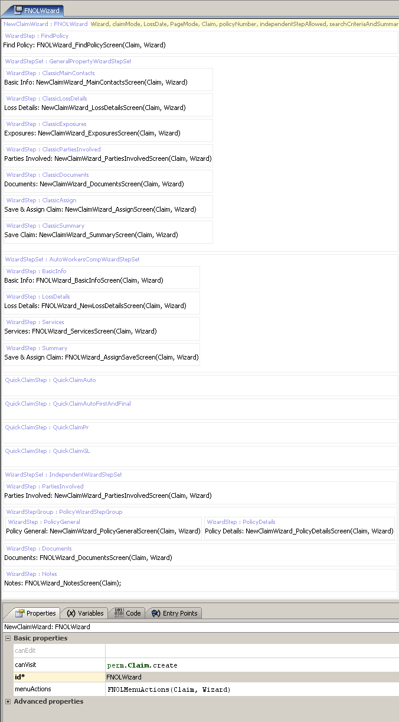
Example PCF file: FNOLWizard
"Ordered" steps for full wizard
"Ordered" steps for quick wizard
Step set for independent steps
Tabs, including:
Properties (menu actions, info bar)
Entry Point (entry points)
Notes:
Wizards - <number>
The PCF file for a wizard consists of steps (either on their own on in step sets). Each step points to a screen. The wizard attributes are specified on the tabs at the bottom.
The steps of a wizard are listed in the following order:
Ordered steps (and which screens they navigate to) for full wizards
Ordered steps (and which screens they navigate to) for quick wizards
Independent steps (and which screens they navigate to)

Slide 14
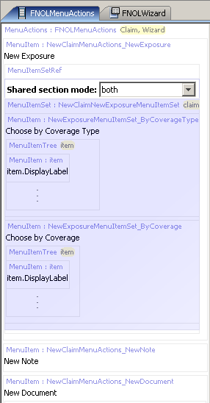
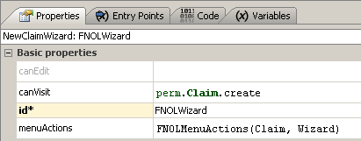
Wizard menu actions
Notes:
Wizards - <number>
The wizard's menuActions property specifies the file to use for contents of the Actions menu.

Slide 15

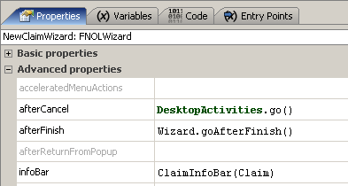
Wizard info bar
Notes:
Wizards - <number>
The wizard's infoBar property specifies the file to use for contents of the info bar. Note that, in the base application, the Claim location group and FNOLWizard wizard use the same info bar.

Slide 16
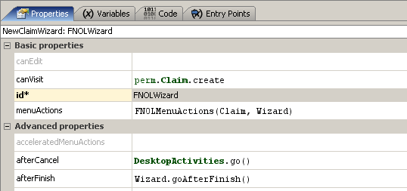
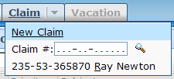

canVisit and canEdit properties
true
false
Notes:
Wizards - <number>
The canEdit attribute determines whether a user can edit the information in the wizard. In some situations, you may want to let a user review the information entered in a wizard at some previous point in time without being able to edit that information. In this case, you would want a canEdit condition which returned false under the appropriate circumstances. (There may be few or no circumstances for this type of functionality in ClaimCenter, but it is used frequently within PolicyCenter to let users view information gathered by an underwriter to create, change, or cancel a policy.)
The canVisit attribute determines whether a user can visit the wizard. If blank, the attribute evaluates to true. When the attribute evaluates to false, any widget navigating to the wizard is not rendered. (This is shown in the example above. The screenshot on the lower left is the Claim tab as seen by an adjuster, who can create claims. The screenshot on the lower right is the Claim tab as seen by a customer service representative, who cannot create claims.

Slide 17
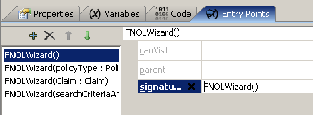
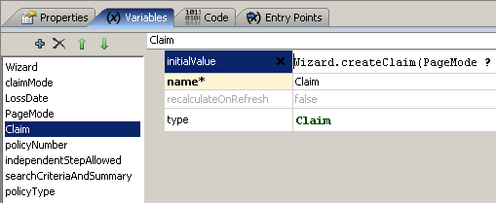
Entry points
Recall that entry point is name for location used by navigation widgets
Each object
expected in each
entry points must
be declared on
variable tab
entry point name
object
name
object
type
Notes:
Wizards - <number>
In the example above, the FNOLWizard wizard has four entry points. The third entry point has a name of "FNOLWizard". It expects a single object of type claim which is referred to within the PCF page as "Claim".
Locations can have multiple entry points. This is useful when a single location can be referenced from different places with different known pieces of information. For example, the FNOLWizard can be accessed with no object (as seen in the first entry point), with a set of information including a PolicyType object (as seen in the second entry point), with a claim (as seen in the third entry point), or with a search criteria (as seen in the fourth entry point).

Slide 18
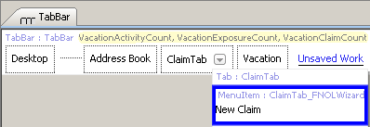
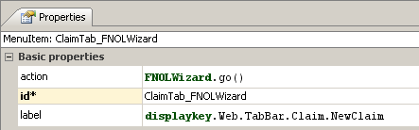

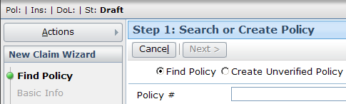
Navigating to wizards
Navigation uses "go()"
Syntax:
  EntryPointOfLocation.go(objectsToPass)
Notes:
Wizards - <number>
Most navigation widgets have an action attribute, which defines where to navigate to when the widget is clicked. The syntax for an action attribute which navigates to a location is:
pcf.LocationEntryPoint.method(objectList), where
LocationEntryPoint is (one of) the location entry point(s) defined on the destination location's Entry Points tab.
method is the method used to navigate to the location (which, for location groups, is almost always "go").
objectList is a comma-delimited list of zero to many objects. This list must match the number of objects and the type which are expected by the location entry point.
In the example above, the Claim tab has a New Claim menu item. This menu item has an action of "FNOLWizard.go()". The go method indicates that clicking the menu item should navigate the user to that location. (The empty parentheses indicate that no object is to be passed to that location.) The location to navigate to is the one that has an entry point of "FNOLWizard".
The FNOLWizard PCF file has an Entry Points tab. From this tab, four entry points have been defined, including one which is "FNOLWizard" with no arguments. Because this corresponds to the menu item, this is the location to which the user will be navigated when the user clicks the menu item.

Slide 19
Lesson outline
Wizard basics
Wizard configuration
Wizard step configuration
Notes:
Wizards - <number>

Slide 20

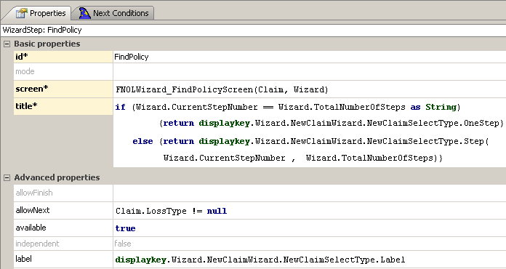
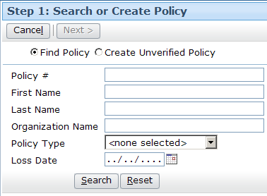
Screens are referenced by steps
When clicked, what
screen is displayed?
Notes:
Wizards - <number>
Each wizard step has a screen attribute. This specifies the screen which the step points to. If the destination screen requires one or more objects, then the screen attribute must specify which objects to pass

Slide 21
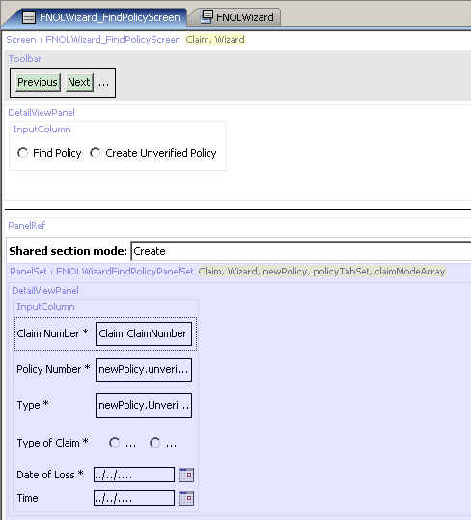
Screen PCFs
Screen PCF file contains references to all embedded content
Notes:
Wizards - <number>

Slide 22
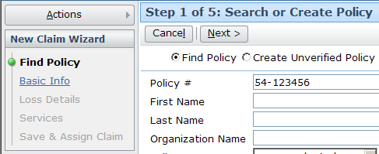
Screen-related labels
Notes:
Wizards - <number>
The wizard step's title attribute determines the text displayed in the title bar for the given step. In the example above, the attribute is set to a condition. If the current step number equals the total number of steps (which would be true if the wizard was a one-step wizard, then the display key "Wizard.NewClaimWizard.NewClaimSelectType.OneStep" is displayed, which in the English locale is set to "Step 1: Search or Create Policy". Otherwise, the display key "Wizard.NewClaimWizard.NewClaimSelectType.Step" is used, which in the English locale is set to "Step {0} of {1}: Search or Create Policy". Two arguments are passed in and occupy the positions {0} and {1}.
The step's label attribute determines the text displayed in the sidebar for the given step. In the example above, the attribute is set to the display key "Wizard.NewClaimWizard.NewClaimSelectType.Label", which in the English locale is set to "Find Policy".

Slide 23
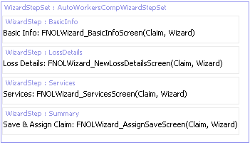
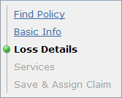
Order of wizard steps
Determined by order in which they appear in PCF file
  Wizard displays all visible steps in order declared
    Dependent steps are always in top box
    Independent steps are always in bottom box
Notes:
Wizards - <number>

Slide 24
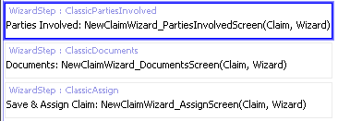
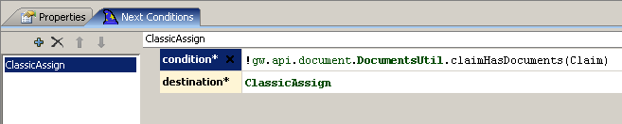
Next steps
if claim does not have documents, go to ClassicAssign
Wizard step can have a "next" condition
  When false, wizard advances to next step in sequence
  When true, wizard advances to specified step
Notes:
Wizards - <number>
In the example above, the ClassicPartiesInvolved step has a next condition. The condition's logic is, essentially, "if the claim does not have documents, use ClassicAssign as the destination step". If a claim has documents, it advances to the next step in order, ClassicDocuments. If the claim does not have documents, it advances to the destination step, ClassicAssign, thereby skipping over ClassicDocuments.

Slide 25
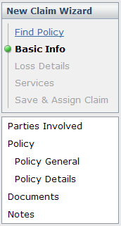


Independent wizard steps
To make a step independent, set independent attribute to true
Notes:
Wizards - <number>

Slide 26
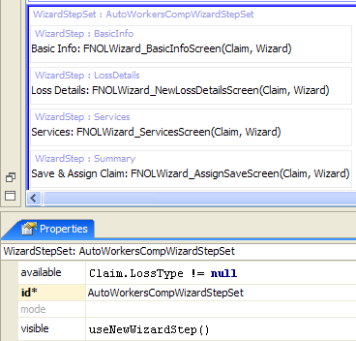
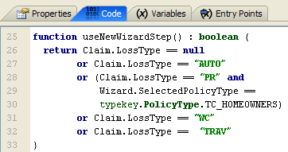
Wizard step sets
This Wizard step set visible only if loss type is Auto, WC, Property, Travel
A wizard step set is a set of wizard steps which have shared logic (visible, available, mode) and can be inserted into a wizard as a group
Notes:
Wizards - <number>
In the ClaimCenter 6.0 base application, there is one set of wizard steps used for auto, workers' comp, travel, and homeowners' claims and a different set of wizard steps used for other property and liability claims.
The availability and visibility logic for a wizard step set is accessible in the properties window. In the ClaimCenter 6.0 base application, the step set shown above makes use of a "useNewWizardStep" function, which is declared on the wizard's Code tab.

Slide 27
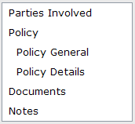
Wizard step groups
A wizard step group is a set of wizard steps which:
  Are indented
  Have a single parent label
Notes:
Wizards - <number>
Wizard step groups have a visible attribute, but they do not have an available attribute. Wizard step groups are intended for creating a collection of "child" steps or "sub" steps, as opposed to wizard step sets, which are intended to gather a set of steps which should be treated as a logic unit.

Slide 28
Lesson objectives review
You should now be able to:
  Describe the architecture of a wizard
  Configure existing wizards
  Create and modify wizard steps
Notes:
Wizards - <number>

Slide 29
Review questions
Name three things that are true of a wizard that are not true of a location group.
Why would you want to put wizard steps into a step set? A step group?
What attribute controls the order of appearance of wizard steps in the user interface?
How does a step behave differently if you set its independent attribute to true?
What is a wizard's entry point? What other elements of the user interface reference a wizard's entry point?
Notes:
Wizards - <number>
Answers
1. Possible answers:
Wizard screens are ordered.
Wizards have toolbars used to navigate through the ordered screens.
Wizard screen toolbars can have buttons that execute workflow triggers.
Wizard screens can have conditional availability tied to where you are at in the wizard.
2. You might put steps into a step set when you want to control the visibility or availability of multiple steps with a single condition. You might put steps into a step group when you want the steps to be indented with a single label displayed over all of them.
3. There is no attribute that controls the order of appearance. Order of appearance is based on the order in which the wizard steps are listed in the PCF file.
4. If a step is independent, then it is listed at the bottom and it cannot be navigated to using the Back/Next toolbar buttons.
5. A wizard's entry point is the internal name for the wizard. It is used by navigation widgets which navigate to the wizard when clicked.

Slide 30
Notices
Copyright © 2001-2011 Guidewire Software, Inc. All Rights Reserved.
Guidewire, Guidewire Software, Guidewire ClaimCenter, Guidewire PolicyCenter, Guidewire BillingCenter, Guidewire Reinsurance Management, Guidewire ContactManager, Guidewire Vendor Data Management, Guidewire Client Data Management, Guidewire InsuranceSuite, Guidewire ContactCenter, Guidewire Studio, Gosu, Deliver Insurance Your Way, and the Guidewire logo are trademarks or registered trademarks of Guidewire Software, Inc. in the United States and/or other countries.
This material is Guidewire proprietary and confidential. The contents of this material, including product architecture details and APIs, are considered confidential and are fully protected by customer licensing confidentiality agreements and signed Non-Disclosure Agreements (NDAs).
This file and the contents herein are the property of Guidewire Software, Inc. Use of this course material is restricted to students officially registered in this specific Guidewire-instructed course, or for other use expressly authorized by Guidewire. Replication or distribution of this course material in electronic, paper, or other format is prohibited without express permission from Guidewire.
    Guidewire products are protected by one or more of the following patents: U.S. Patent No. 7,885,831; U.S. Patent No. 7,788,296.
Notes:
Introduction to Guidewire Configuration - <number>

